Slide 1

PROJECT SEMINAR ON
FACE AND EYE DETECTION USING PYTHON AND ARTIFICIAL INTELLIGENCE
Under the Esteemed Guidance of
Mr.T.Nagarjun
Assistant Professor of C.S.E
Abhishek Banda 167W1A0597
Duggu Harish Kumar 167W1A0598
Ankit 167W1A05A0
Ejenthkar Amarnath Ajay 157W1A0521
Katakam Nagaraju 157W1A0535

Slide 2

CONTENTS
Abstract
Introduction
System Specifications
Algorithm
Screenshots
Pros and Cons
Usability
Conclusion
Future Enhancement

Slide 3
Abstract
Face detection can be regarded as a specific case of object-class detection.
In object-class detection, the task is to find the locations and sizes of all objects in an image that belong to a given class.
Firstly, the possible human eye regions are detected by testing all the valley regions in the gray level image.
Then the genetic algorithm is used to generate all the possible face regions which include the eyebrows, the iris, the nostril and the mouth corners.

Slide 4
Introduction
Face detection is a computer technology being used in a variety of applications that identifies human faces in digital images.
Face detection also refers to the psychological process by which humans locate and attend to faces in a visual scene.
Face detection is used in biometrics, often as a part of (or together with) a facial recognition system. It is also used in video surveillance, human computer interface and image database management.
Face detection can be used as part of a software implementation of emotional inference. Emotional inference can be used to help people with autism understand the feelings of people around them.

Slide 5
System Specifications
Hardware Specification
CPU : CORE I3/I5/I7 PROCESSOR
SPEED : 2 GHz COPROCESSOR
TOTAL RAM : 8 GB
HARD DISK : 500 GB
KEYBOARD : 105 KEYS
MOUSE : LOGITECH MOUSE
DISPLAY : SGVA COLOR
Software Specifications
TECHNOLOGY : MACHINE LEARNING
PROGRAMMING LANGUAGE : PYTHON
DISTRIBUTION : ANACONDA
OPERATING SYSTEM : WINDOWS 8/WINDOWS 10

Slide 6
Algorithm
Step 1:Create a new Python file using the following command:
gedit filename.py
Step 2:Now before starting the code import the modules of OpenCV as following :
import numpy as np
import cv2
Step 3:The cascade classifiers
face_cascade=cv2.CascadeClassifier(‘/root/opencv/data/haarcascades/haarcascade_frontalface_default.xml’)
eye_cascade=cv2.CascadeClassifier(‘root/opencv/data/haarcascades/haarcascade_eye.xml’)
Step 4:The imread() function
img=cv2.imread(‘/root/Desktop/image.jpg’).

Slide 7
Step 5:The cvtcolor() function
cv2.cvtColor(img, cv2.COLOR_BGR2GRAY)
Step 6:The imshow() function
cv2.imshow(‘img’,img)
Step 7:The waitkey() function
cv2.waitkey()
Step 8:The destroyAllWindows() function
cv2.destroyAllWindows
Step 9:Simply run your code with the help of following command
python filename.py

Slide 8

Screenshots
Figure:Anaconda Navigator

Slide 9

Figure:Anaconda Prompt

Slide 10
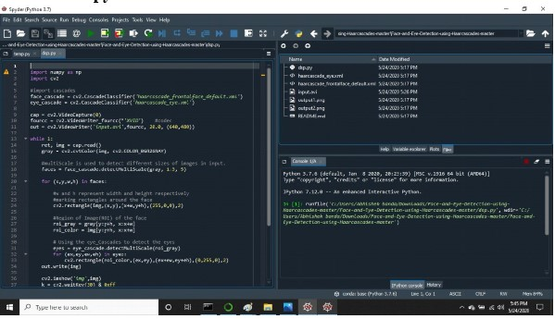
Figure:Running Code and Files in Spyder

Slide 11
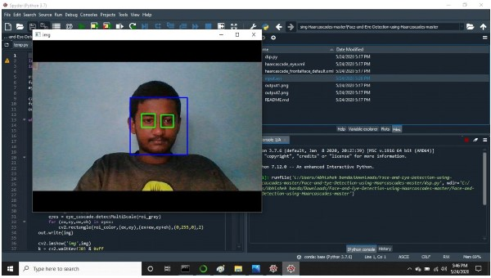
Figure: Face and Eyes Detected

Slide 12
Pros and Cons
Pros
There are many benefits to face recognition systems such as its convenience and Social acceptability.all you need is your picture taken for it to work.
Face recognition is easy to use and in many cases it can be Performed without a person knowing.
Face recognition is also one of the most inexpensive biometric in the market and its price should continue to go down.
Cons
Face recognition systems can’t tell the difference between identical twins.

Slide 13
Usability
Face Detection is the first and essential step for face recognition,and it is used to detect faces in images.
It is part of object detection and can use in many areas such as security,biometrics,law enforcement,entertainment,personal safety,etc.
Object detection such as face and eye detection is an important step in many vision based applications which may include video surveillance,tracking,medical analysis,facial expression.

Slide 14
Conclusion
Face recognition technology has come a long way in the last twenty years. Today, machines are able to automatically verify identity information for secure transactions, for surveillance and security tasks, and for access control to buildings etc.
These applications usually work in controlled environments and recognition algorithms can take advantage of the environmental constraints to obtain high recognition accuracy.
However, next generation face recognition systems are going to have widespread application in smart environments -- where computers and machines are more like helpful assistants.

Slide 15
Future Enhancement
Face recognition systems used today work very well under constrained conditions, although all systems work much better with frontal mug-shot images and constant lighting.
All current face recognition algorithms fail under the vastly varying conditions under which humans need to and are able to identify other people.
Next generation person recognition systems will need to recognize people in real-time and in much less constrained situations.
Cameras and microphones today are very small, light-weight and have been successfully integrated with wearable systems. Audio and video based recognition systems have the critical advantage that they use the modalities humans use for recognition.
Finally, researchers are beginning to demonstrate that unobtrusive audio-and-video based person identification systems can achieve high recognition rates without requiring the user to be in highly controlled environments

Slide 16
Thank you

